Slide 1
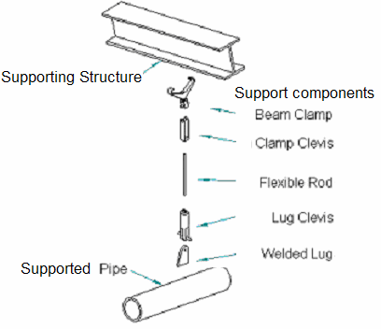
Hanger and Support Overview
The Hangers and Supports environment is used to model supports for piping, HVAC ducts, and cable trays.
A support is an assembly of parts, also called components, which connect together to the supported features, and to the supporting structure.
Supports Assemblies and support parts are pre-defined in the SP3D Catalog.

Slide 2
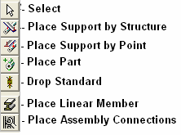
Hanger and Support Commands
Place Support by Structure command positions the support where the selected supporting structure crosses the selected feature.
Place Support by Point command to manually identify the point where the supporting structure is a plane or runs parallel to the route path.
Place Part command gives you the ability to manually place support parts into a Designed Support
Drop Standard Command Coverts a standard Support into a Design Support for modification of parts.
Place Assembly Connection command places connections between the members by trimming the members and adding connection parts as defined by the assembly connection type chosen.
Place Linear Member commands places structural members that can be used to aid in the design of custom supports

Slide 3
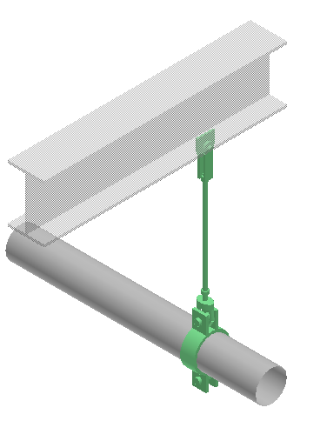
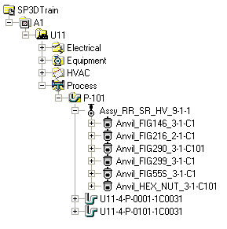
Hangers & Supports – Standard Supports
The Standard Support automatically selects the individual parts from the Catalog and positions them based on the supported parts, the supporting structure, and the position of the support.

Slide 4
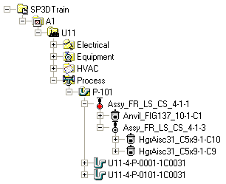
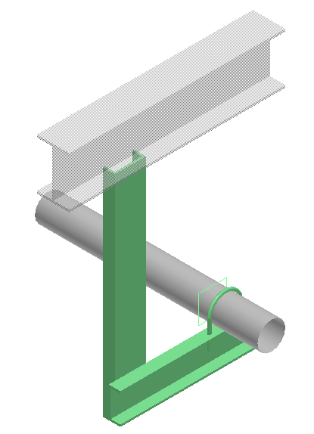
Hangers & Supports – Designed Supports
The Designed Support is a custom configuration of parts. You create the Designed Support by selecting the option to place a Designed Support instead of a Standard Support on the ribbon of the support placement commands. The Designed Support option creates reference graphics at the identified support location instead of placing parts. You can manually place support parts in the Designed Support by using the Place Part command (see below for more details). You can use the reference graphics of the Designed Support to help position the support parts.

Slide 5
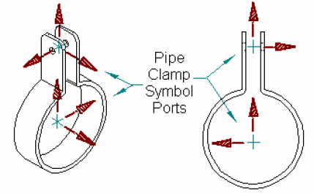
Hangers & Supports - Parts
You place support parts manually by using the Place Part command. The command prompts you to select the parent support. If you want to add support parts to a Standard Support, you can just pick the Standard Support as the system parent of the support part. The software automatically converts the Standard Support to a Designed Support when the part is placed.
Support parts have pre-defined positioning locations called ports. These ports carry information about how they assemble relative to supported features, other support part ports, and the supporting structure. This information makes it easy to assemble parts that must connect.
– <number> –

